Slide 1
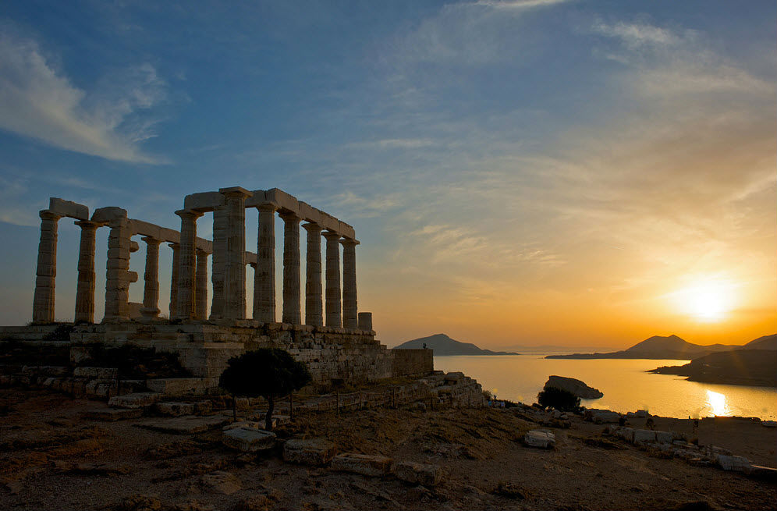

Slide 2
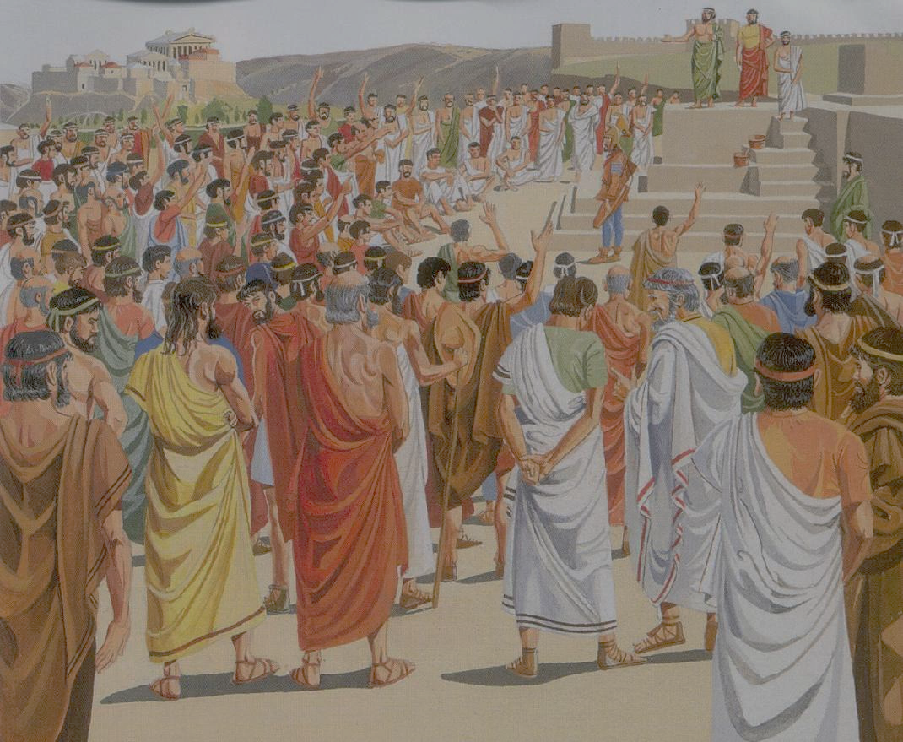
What is a State?
A state is a body of people living in a defined territory with a government
As opposed to these terms:
Nation- ethnic term: large group of people
Country- geographic term: particular place, region or area of land

Slide 3
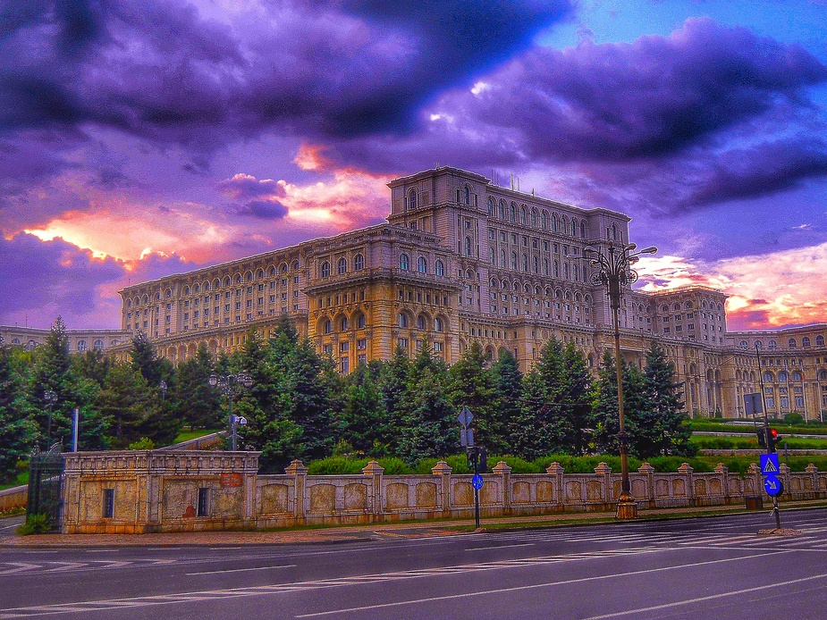
Notes:
Photo: The Palace of the Parliament of Romania in central Bucharest.

Slide 4
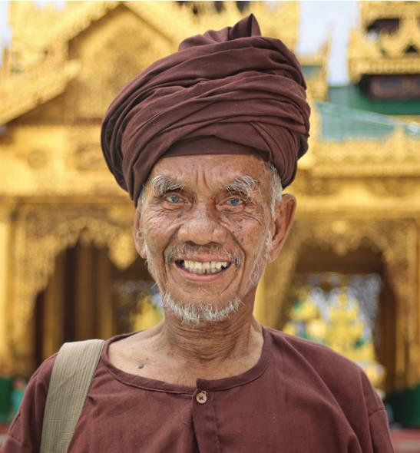
Must have people
Size doesn’t matter
People who make up the state may or may not be homogeneous (share customs, language, ethnic background
San Marino- ??? people
China- ??? people

Slide 5
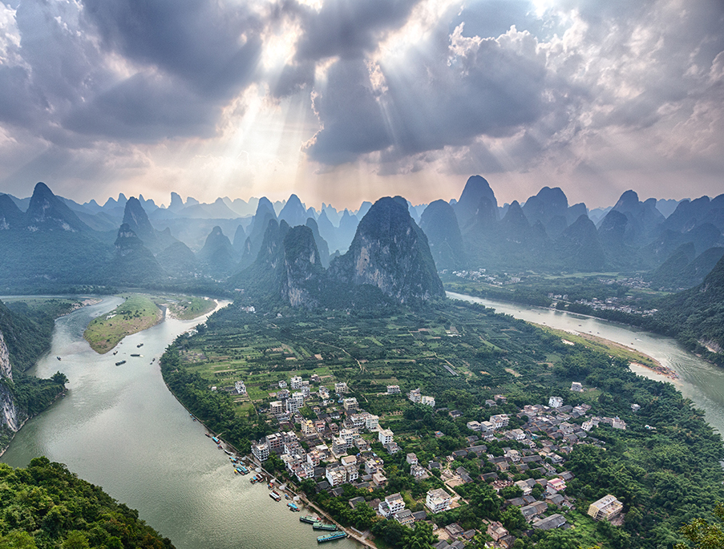
Must have land with known and recognized boundaries
Vatican City- 0.2 square miles
Russia- 6.6 million square miles
Notes:
Picture is of the tiny village of Xingping in western China.

Slide 6
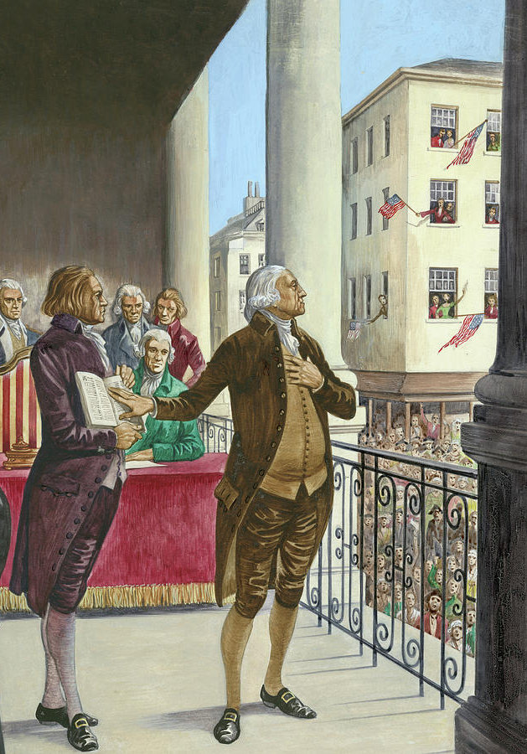
Supreme and absolute power within its own territory
Can decide its own foreign and domestic policies
One of the main characteristics that distinguishes the state from smaller political units

Slide 7
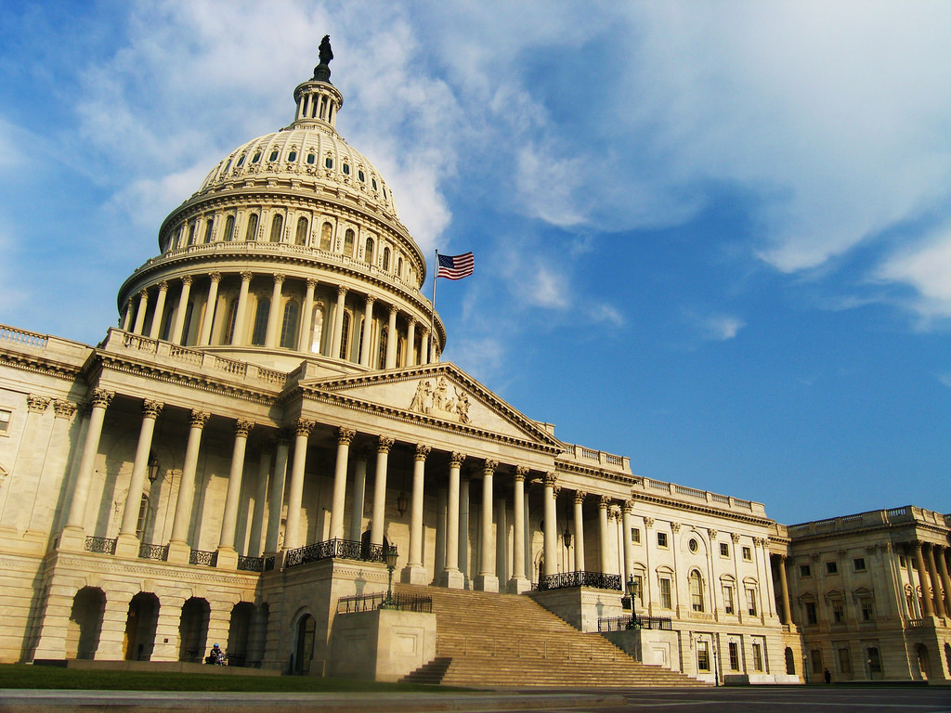
Each state is politically organized
Government - the agency the state uses to accomplish goals

Slide 8
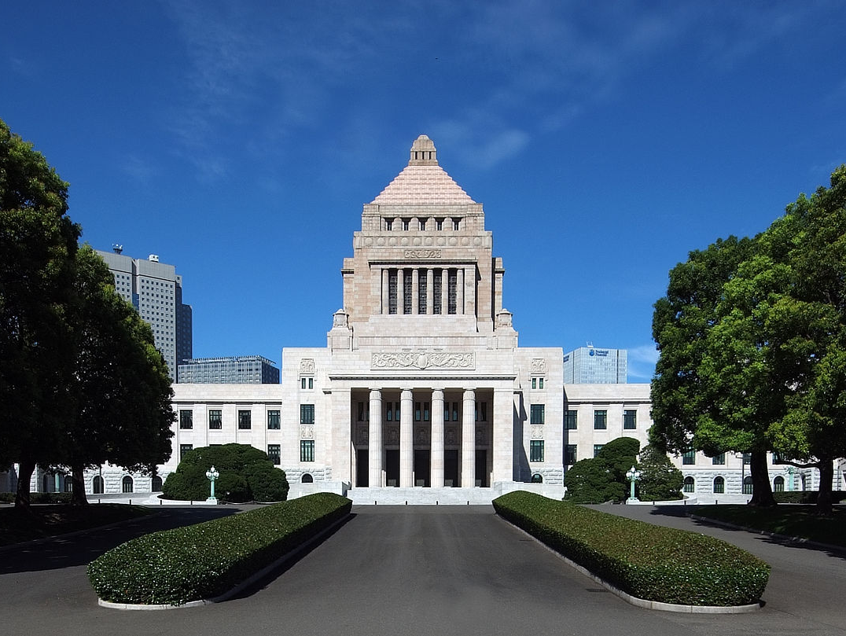
Institution which makes and enforces public policies
Public policies include defense, crime, education, health care, transportation, civil rights, etc.

Slide 9
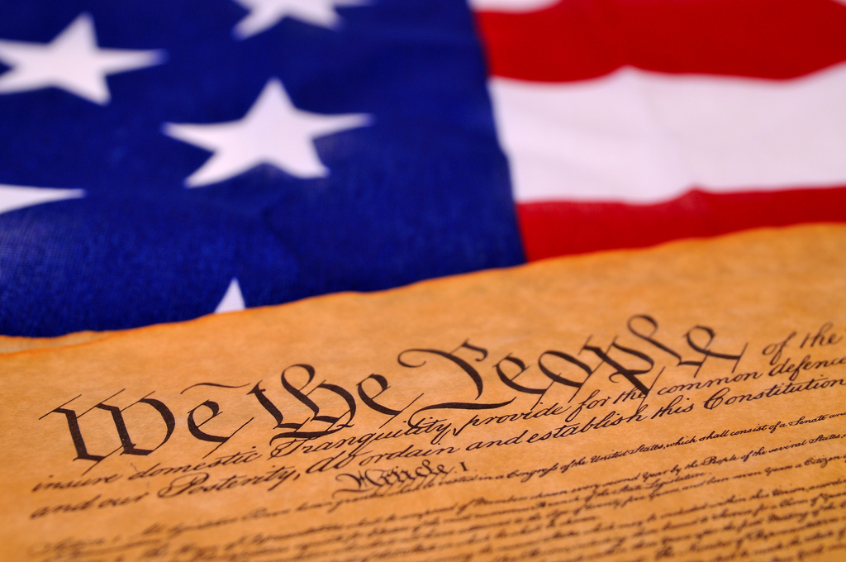
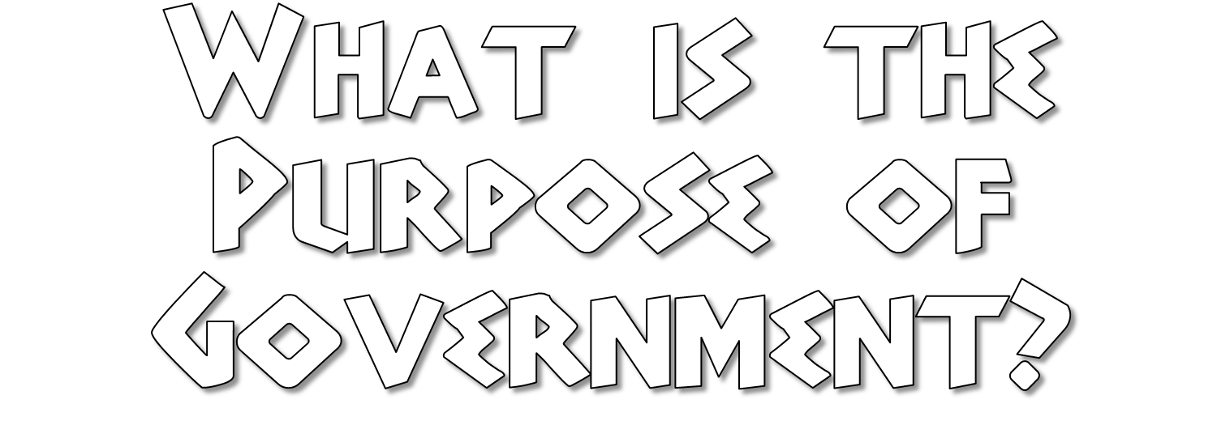

Slide 10
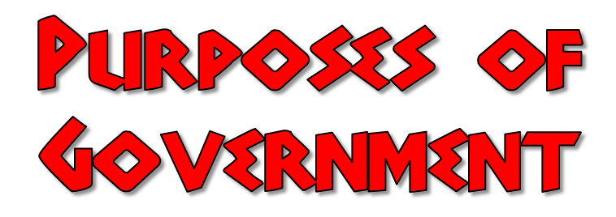
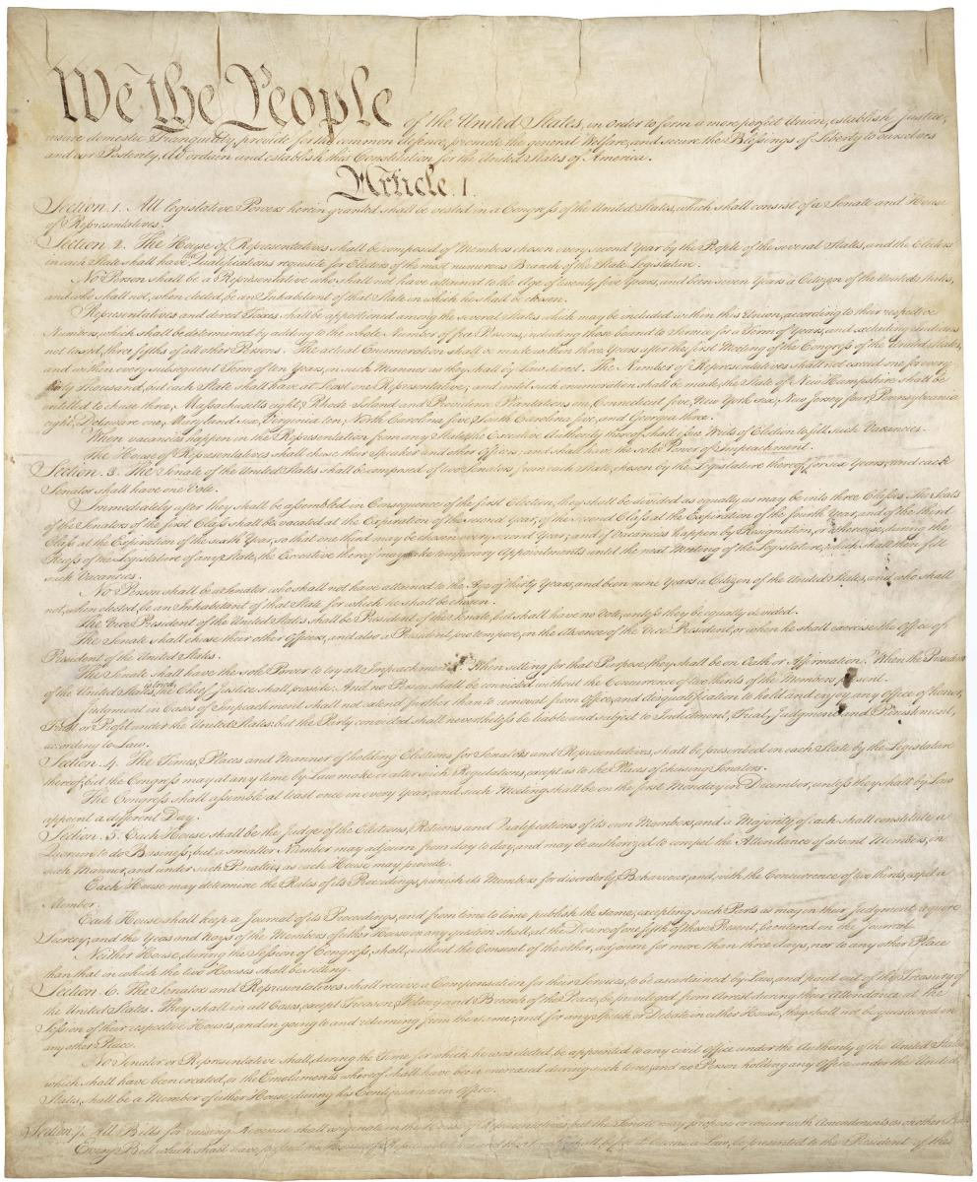
To Form a More Perfect Union- In union, there is strength
To guarantee civil rights and liberties
To promote the general welfare of citizens
To Establish Justice: The law must be reasonable, fair and impartial
To ensure domestic tranquility (ie: Police, laws): order is essential to society
To provide for common defense against outside attack

Slide 11
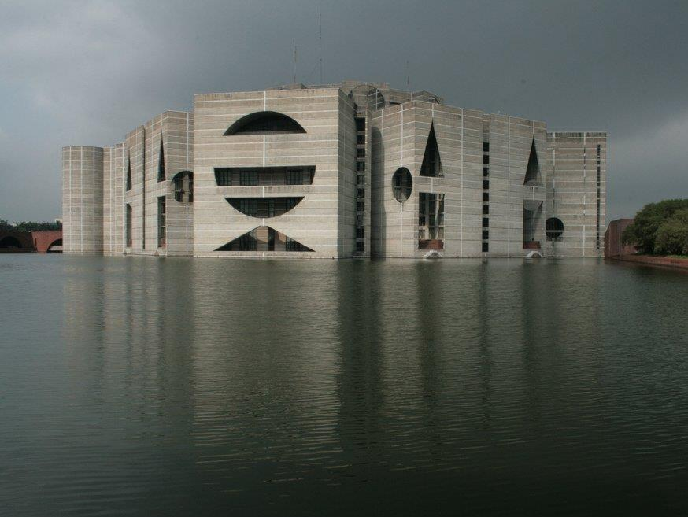
Legislative- Law making- (US Congress, State Legislatures)
Executive- Law enforcing (US President, Governor)
Judicial- Law interpreting (Courts)
Notes:
Photo: Jatiya Sangsad Bhaban or National Parliament House, the house of the Parliament of Bangladesh.

